Slide 1
Affymetrix Microarray Tutorial

Slide 2
Overview
1. Get Data
2. QC on Non-Normalized Data
8. Annotating Probes
3. Normalization
9. Collapse Rows
4. Batch Correction
10. Differential Expression Analysis
5. Outlier Removal
6. QC on Normalized Data
7. Covariate Analysis

Slide 3
1. Get Data
datExpr Basic
Probe Sample | Sample 1 | Sample 2 | Etc…
Probe A | 3 | 4
Probe B | 2 | 8
Etc….
– Note that expression numbers are not representative of real data in this example

Slide 4
1. Get Data
datMeta Basic
Sample Category | Label | Gender | Location | Etc…
Sample 1 | Label A | Male | PreFrontal Cortex
Sample 2 | Label B | Female | Putamen
Etc…
datMeta Example
Sample | GSM | Group | Region
N1A Normal-frontal | GSM329660 | CTL | FCX
N1C Normal-hippocampus | GSM329661 | CTL | HPC
N1B Normal-cerebellum | GSM329662 | CTL | CBL

Slide 5
Overview
1. Get Data
2. QC on Non-Normalized Data
8. Annotating Probes
3. Normalization
9. Collapse Rows
4. Batch Correction
10. Differential Expression Analysis
5. Outlier Removal
6. QC on Normalized Data
7. Covariate Analysis

Slide 6
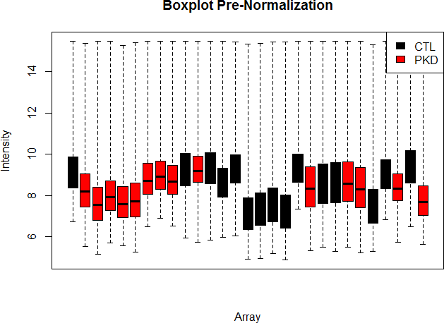
2. QC on Non-Normalized Data

Slide 7
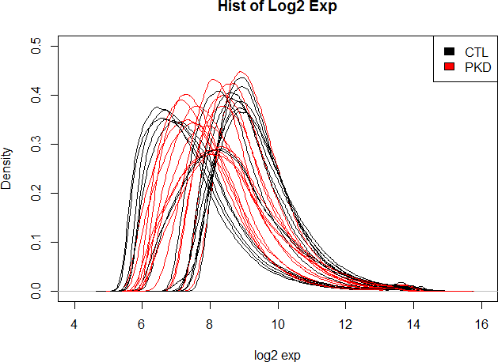
2. QC on Non-Normalized Data

Slide 8
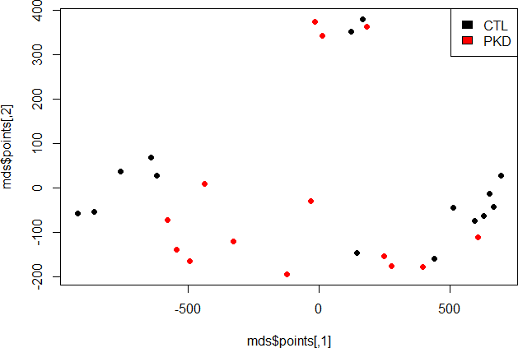
2. QC on Non-Normalized Data
MDS

Slide 9
Overview
1. Get Data
2. QC on Non-Normalized Data
8. Annotating Probes
3. Normalization
9. Collapse Rows
4. Batch Correction
10. Differential Expression Analysis
5. Outlier Removal
6. QC on Normalized Data
7. Covariate Analysis

Slide 10
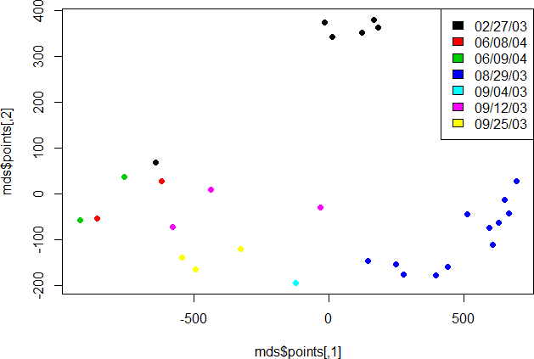
4. Batch Correction
MDS Post-Normalization Pre-Batch Correction

Slide 11
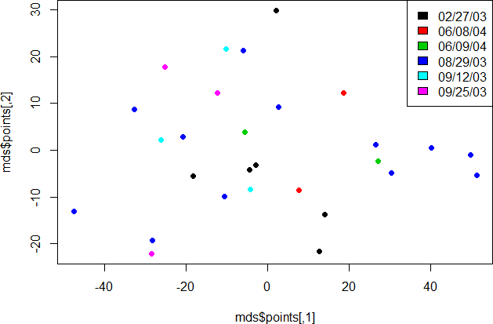
4. Batch Correction
MDS Post-Normalization Post-Batch Correction

Slide 12
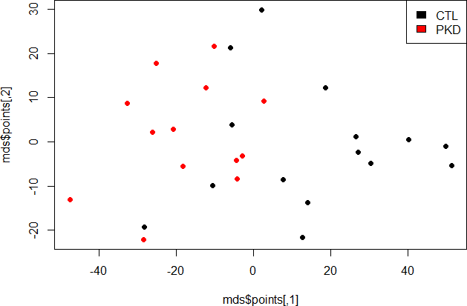
4. Batch Correction
MDS Post-Normalization Post-Batch Correction

Slide 13
Overview
1. Get Data
2. QC on Non-Normalized Data
8. Annotating Probes
3. Normalization
9. Collapse Rows
4. Batch Correction
10. Differential Expression Analysis
5. Outlier Removal
6. QC on Normalized Data
7. Covariate Analysis

Slide 14
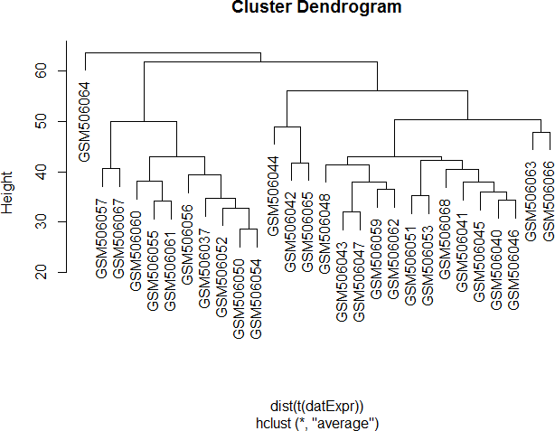
5. Outlier Removal

Slide 15
Overview
1. Get Data
2. QC on Non-Normalized Data
8. Annotating Probes
3. Normalization
9. Collapse Rows
4. Batch Correction
10. Differential Expression Analysis
5. Outlier Removal
6. QC on Normalized Data
7. Covariate Analysis

Slide 16
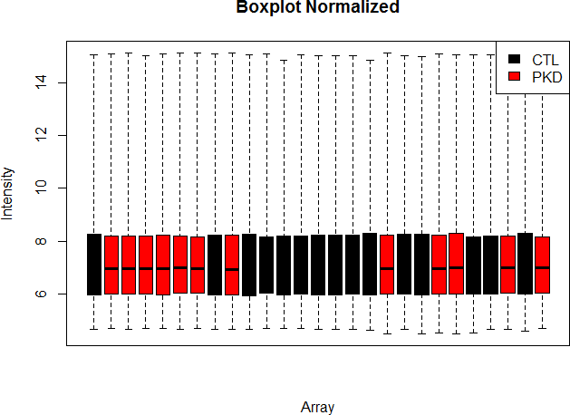
6. QC on Normalized Data

Slide 17
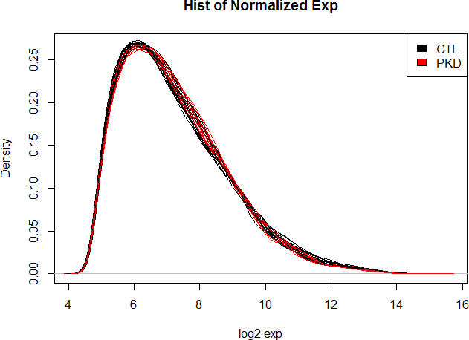
6. QC on Normalized Data

Slide 18
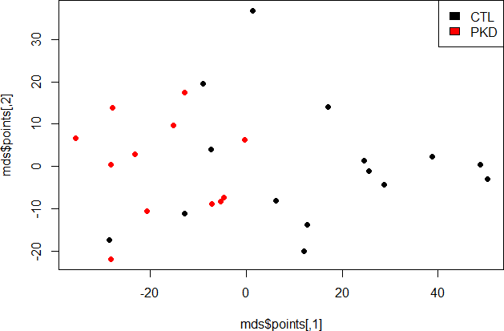
6. QC on Normalized Data
MDS

Slide 19
Overview
1. Get Data
2. QC on Non-Normalized Data
8. Annotating Probes
3. Normalization
9. Collapse Rows
4. Batch Correction
10. Differential Expression Analysis
5. Outlier Removal
6. QC on Normalized Data
7. Covariate Analysis

Slide 20
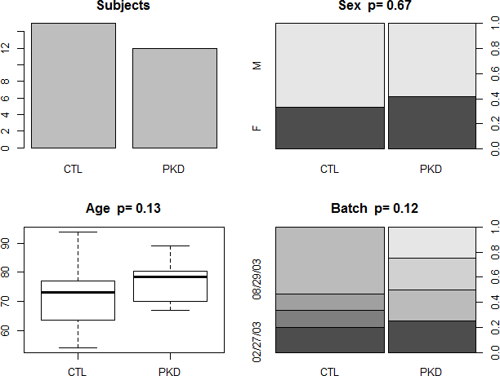
7. Covariate Analysis

Slide 21
Overview
1. Get Data
2. QC on Non-Normalized Data
8. Annotating Probes
3. Normalization
9. Collapse Rows
4. Batch Correction
10. Differential Expression Analysis
5. Outlier Removal
6. QC on Normalized Data
7. Covariate Analysis

Slide 22
8. Annotating Probes
Example geneDat
Probe Identifier | Affy_probe | Ensembl_ID | Etc…
209_at | 209_at | ENS00001
369_at | 369_at | ENS00345
Etc….

Slide 23
Overview
1. Get Data
2. QC on Non-Normalized Data
8. Annotating Probes
3. Normalization
9. Collapse Rows
4. Batch Correction
10. Differential Expression Analysis
5. Outlier Removal
6. QC on Normalized Data
7. Covariate Analysis

Slide 24
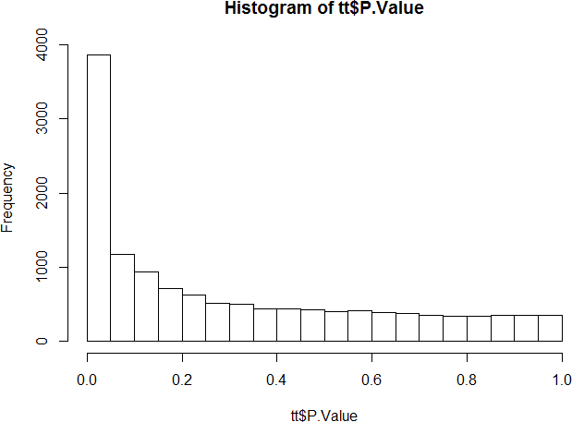
10. Differential Expression Analysis

